Slide 1
Defining features of linear relationships
Task A: Numerical features of linear relationships
1) These are tables of values for linear relationships. Fill in the missing values and complete the statements about the rate of change.
a)
x | −2 | −1 | 0 | 1 | 2 | 3 | 4
y | −8 | −3 | 2 | 7 | 12 | 17 | 22
For every change of +1 in x there is a change of +5 in y
b)
x | −2 | −1 | 0 | 1 | 2 | 3 | 4
y | −18 | −11 | −4 | 3 | 10 | 17 | 24
For every change of +1 in x there is a change of +7 in y
c)
x | −2 | −1 | 0 | 1 | 2 | 3 | 4
y | −1 | 0.5 | 2 | 3.5 | 5 | 6.5 | 8
For every change of +1 in x there is a change of +1.5 in y
d)
x | −2 | −1 | 0 | 1 | 2 | 3 | 4
y | 22 | 17 | 12 | 7 | 2 | −3 | −8
For every change of +1 in x there is a change of −5 in y

Slide 2
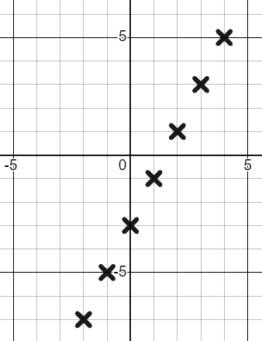
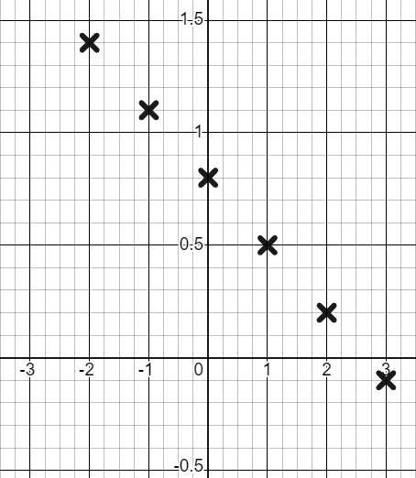
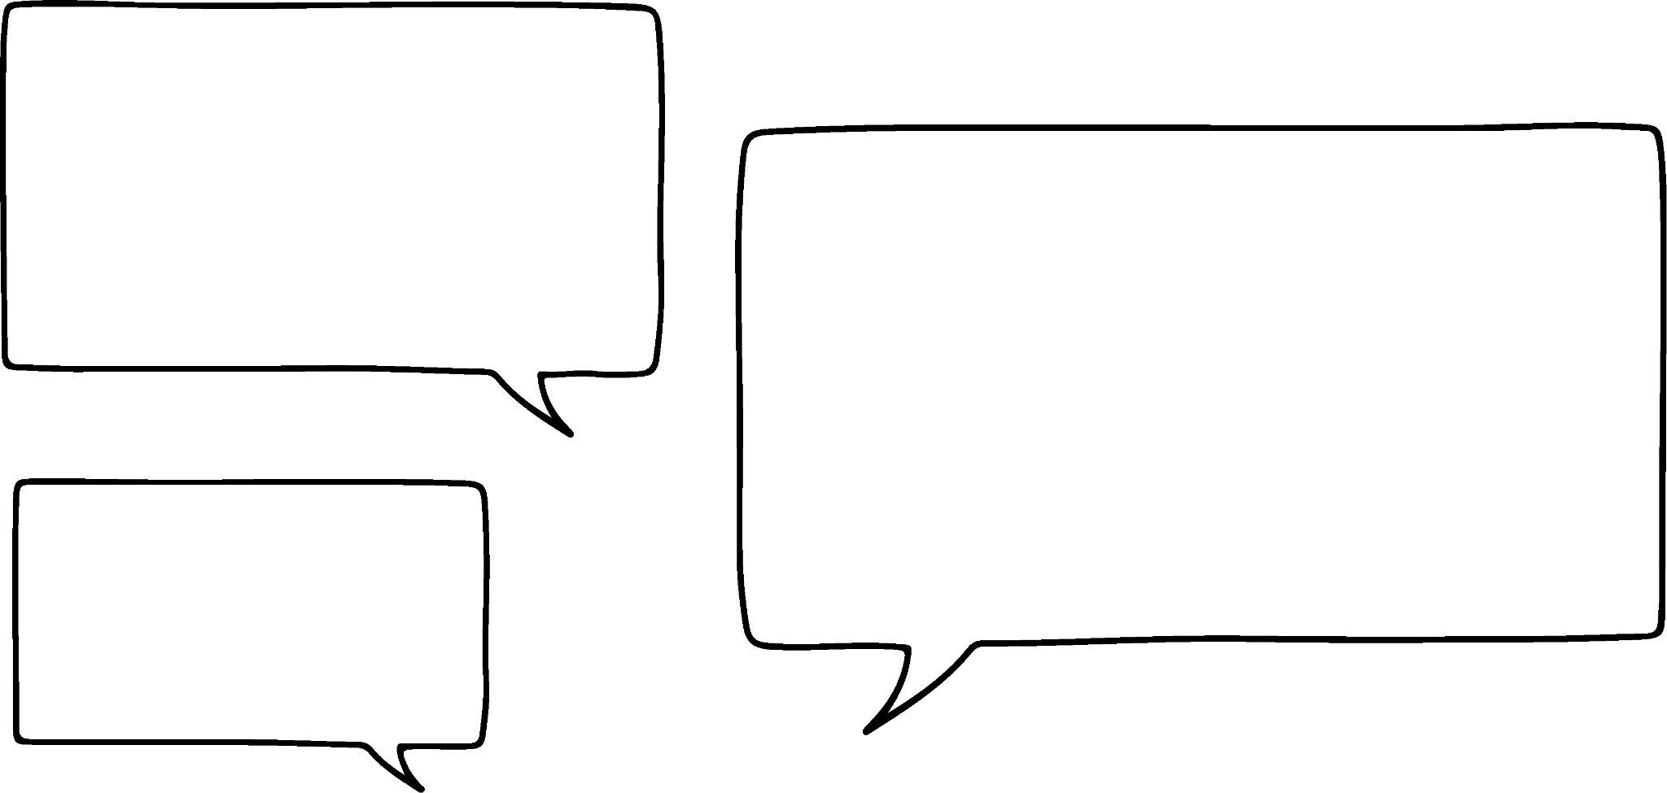

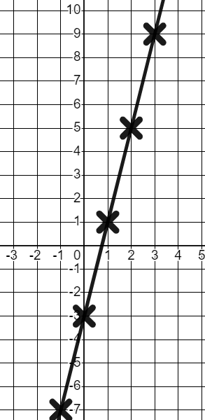
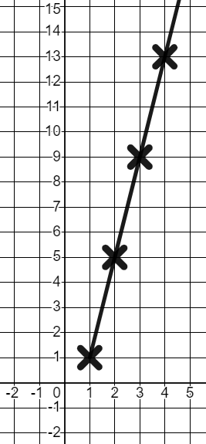
Defining features of linear relationships
2) Use the graph to complete the table and write a sentence about the rate of change.
a)
y
x | −2 | −1 | 0 | 1 | 2 | 3 | 4
y
x | −2 | −1 | 0 | 1 | 2 | 3 | 4
y | −7 | −5 | −3 | −1 | 1 | 3 | 5
x
For every change of +1 in x there is a change of +2 in y
b)
y
x | −2 | −1 | 0 | 1 | 2 | 3
y
x | −2 | −1 | 0 | 1 | 2 | 3
y | 1.4 | 1.1 | 0.8 | 0.5 | 0.2 | −0.1
x
For every change of +1 in x there is a change of −0.3 in y
Task B: Graphical features of linear relationships
1) Izzy has completed a table of values and plotted coordinates for the linear relationship y = 4x − 3
x | −2 | −1 | 0 | 1 | 2 | 3 | 4
y | −11 | −7 | −3 | 1 | 5 | 9 | 13
The line y = 4x − 3 starts at 1 and has a rate of change of +4 each time.
y
The line y = 4x − 3 has no start or end. You need to continue the line in both directions and plot zero and negative x values.
x

Slide 3
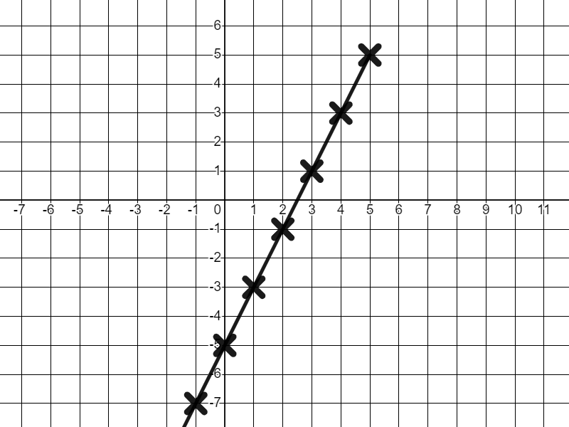
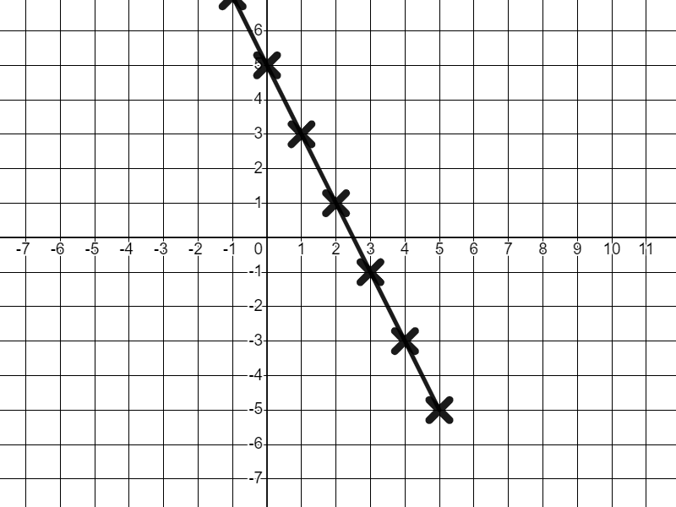
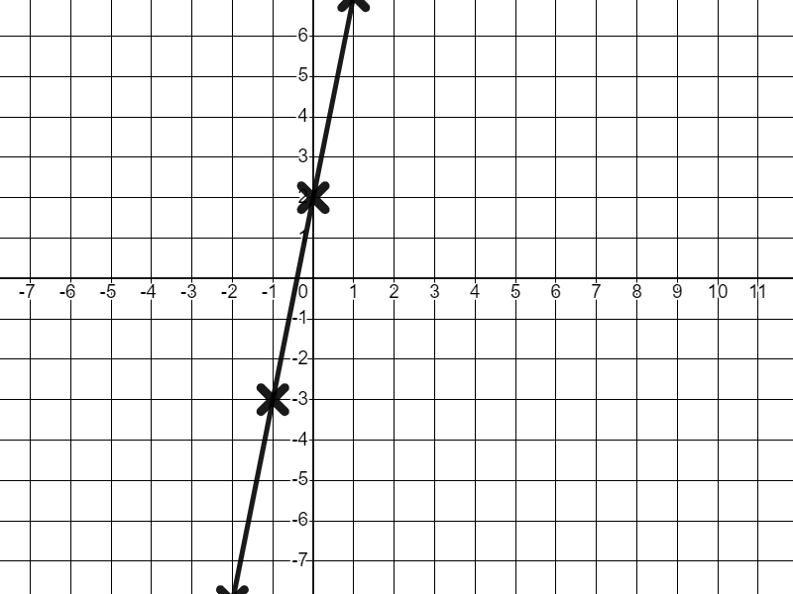
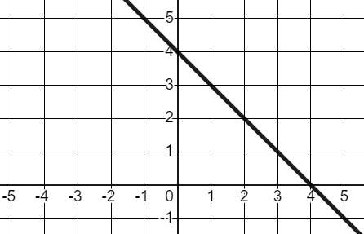
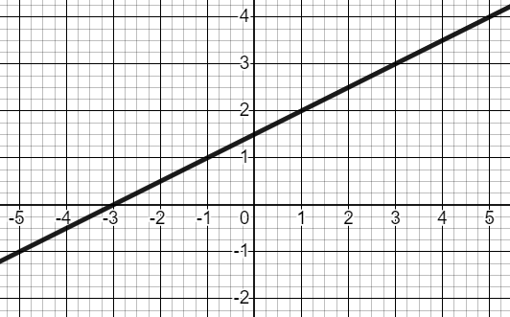
Defining features of linear relationships
2) Match the graphs to their unique descriptions.
Intercepts the y-axis at (0, −5), rate of change of +2
Intercepts the y-axis at (0, 5), rate of change of −2
Intercepts the y-axis at (0, 2), rate of change of +5
3) Write unique descriptions for these two graphs. Be sure to include the words y-intercept and rate of change..
a)
b)
Intercepts the y-axis at (0, 4), rate of change of −1
Intercepts the y-axis at (0, 1.5), rate of change of +0.5
Mathematics in Education and Industry
v2.2

